Slide 1
Air Pollution Monitoring System Using IOT

Slide 2
AGENDA
Problem Statement
Objective
Components Used
Connections
Technologies Used
Output
Future Scope

Slide 3
PROBLEM STATEMENT
Air pollution poses severe health risks and environmental challenges, particularly in urban areas where traditional monitoring systems are limited in scope and responsiveness. There is an need for a cost-effective, real-time solution to monitor air quality comprehensively.
To address this, we propose an IoT-based air pollution monitoring system that deploys sensors to measure Air Quality Index(AQI) and pollutants such as NH3, Sulphur, C02, Benzene. These sensors will transmit data wirelessly to a cloud-based platform for real-time analysis and visualization. This system will provides timely information to mitigate pollution risks, while empowering users with up-to-date air quality data to make informed health decisions.

Slide 4
OBJECTIVES
Real-Time AQI Monitoring: Develop a system for real-time monitoring of the Air Quality Index (AQI) by measuring key pollutants such as NH3 (Ammonia), SO2 (Sulfur Dioxide), CO2 (Carbon Dioxide), and Benzene.
Temperature and Moisture Monitoring: Include sensors to measure temperature and moisture levels, providing a comprehensive understanding of environmental conditions.
Cloud-Based Data Analysis and Visualization: Use a cloud-based platform to analyze and visualize AQI, temperature, and moisture data in real-time, providing actionable insights.
Alert System: Implement an alert system that notifies users and relevant authorities when AQI levels exceed predefined thresholds, enabling timely responses to high pollution levels.

Slide 5
COMPONENTS USED
NodeMCU-ES8266
Temperature Sensor(LM 35)
Moisture Sensor
MQ135 Sensor-For detecting the air quality in ppm
Jumper Wires
Bread Board
USB Cable

Slide 6
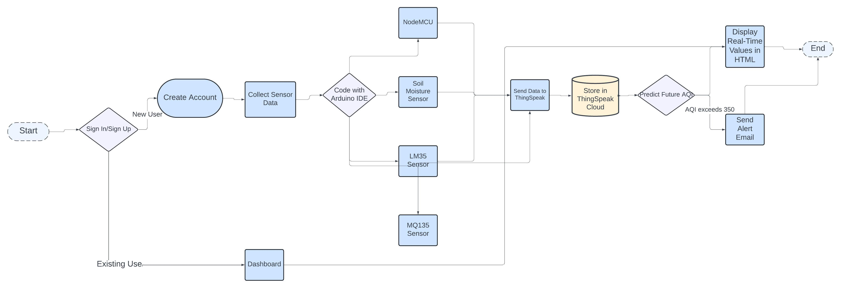
FLOW DIAGRAM

Slide 7
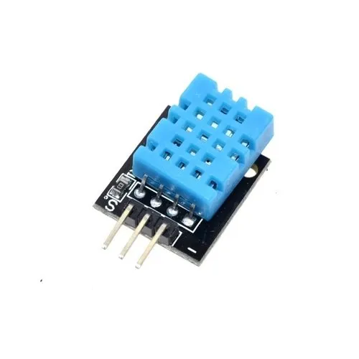
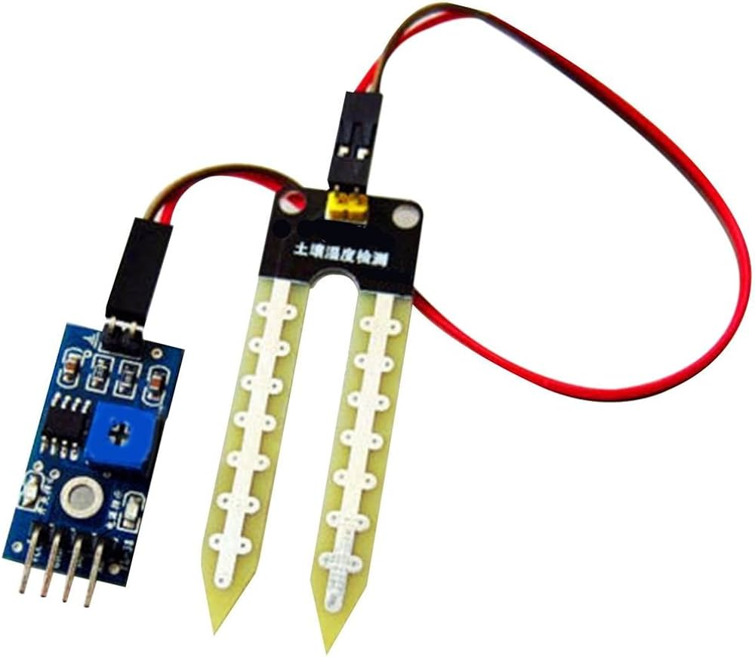
CONNECTIONS MADE
LM35 Temperature:
VCC -> 3.3V (NodeMCU's 3.3V pin)
GND -> GND
Data -> Analog pin (A0)
Moisture Sensor:
VCC -> 3.3V (NodeMCU's 3.3V pin)
GND -> GND
Data -> Analog pin (A0)

Slide 8
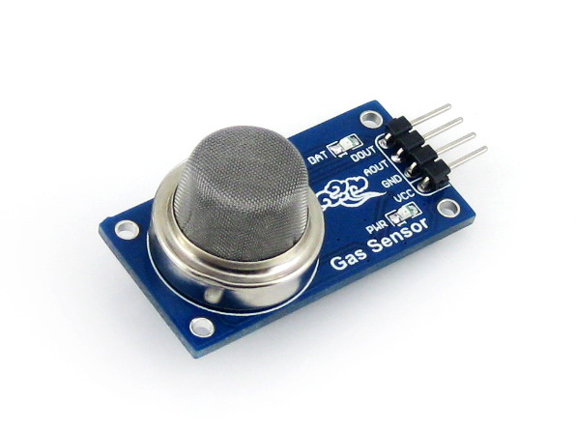
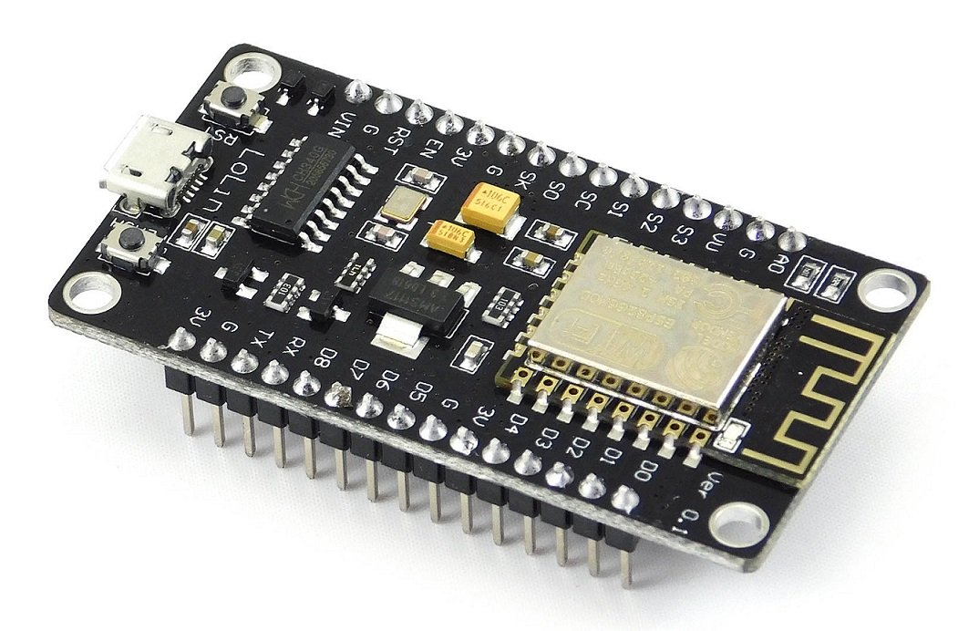
MQ135 Gas Sensor:
VCC -> 3.3V or 5V (Use NodeMCU's 3.3V pin)
GND -> GND
Data -> Analog pin (A0)
NodeMCU:
Connect NodeMCU to laptop via USB.

Slide 9
Code snippets
LIBRARIES INCLUDED
#include <ESP8266WiFi.h>
#include <Wire.h>
#include "MQ135.h"
#define LM35_PIN A0
#define SOIL_PIN A0
MQ135 gasSensor(SOIL_PIN); // MQ135 gas sensor is also using A0
const char* ssid = "SSN";
const char* password = "Ssn1!Som2@Sase3#";
const char* server = "api.thingspeak.com";
const String apiKey = "ZUCOKBJQF9D4LDYP";
WiFiClient client;
SENSING THE VALUES
void loop() {
float t = readLM35Temperature();
float soilMoisture = analogRead(SOIL_PIN);
float air_quality = gasSensor.getPPM();
float nh3 = calculateNH3Concentration();
float benzene = calculateBenzeneConcentration();
float co2 = calculateCO2Concentration();
float so2 = calculateSO2Concentration();

Slide 10


TECHNOLOGY USED
For Setting Up Iot Device:
Arduino IDE C++ Programming
Thingspeak
For designing a Website:
HTML
CSS

Slide 11


Login
Signup
6/26/2024

Slide 12
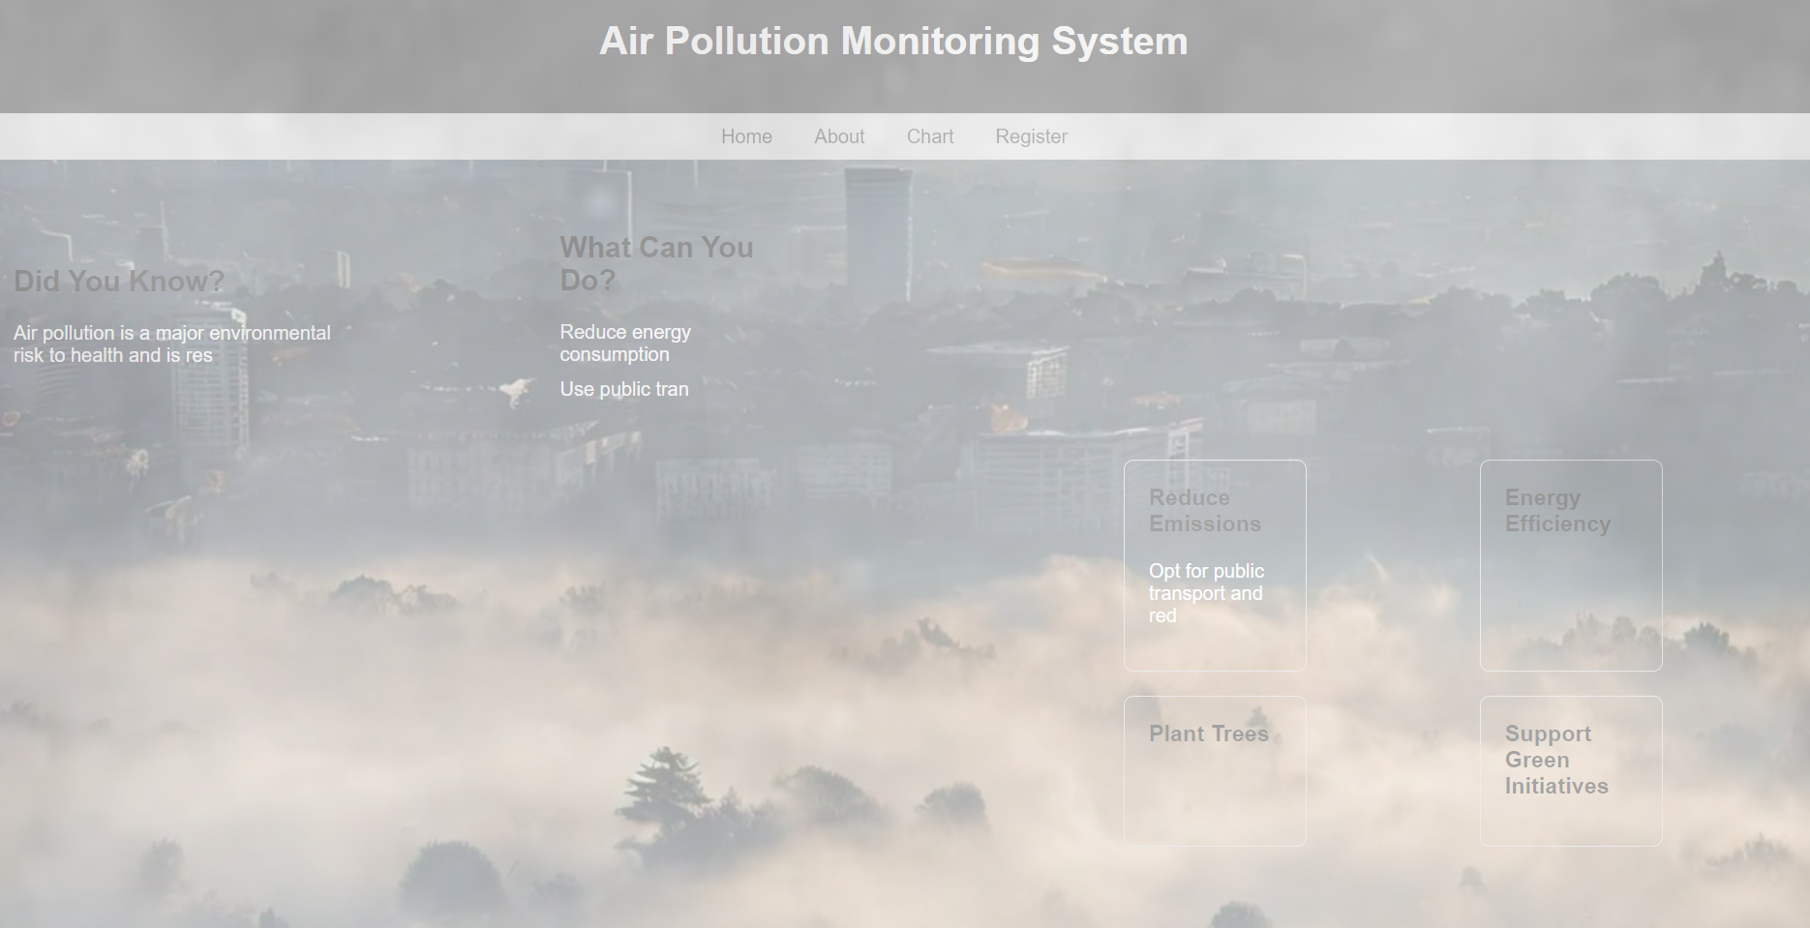
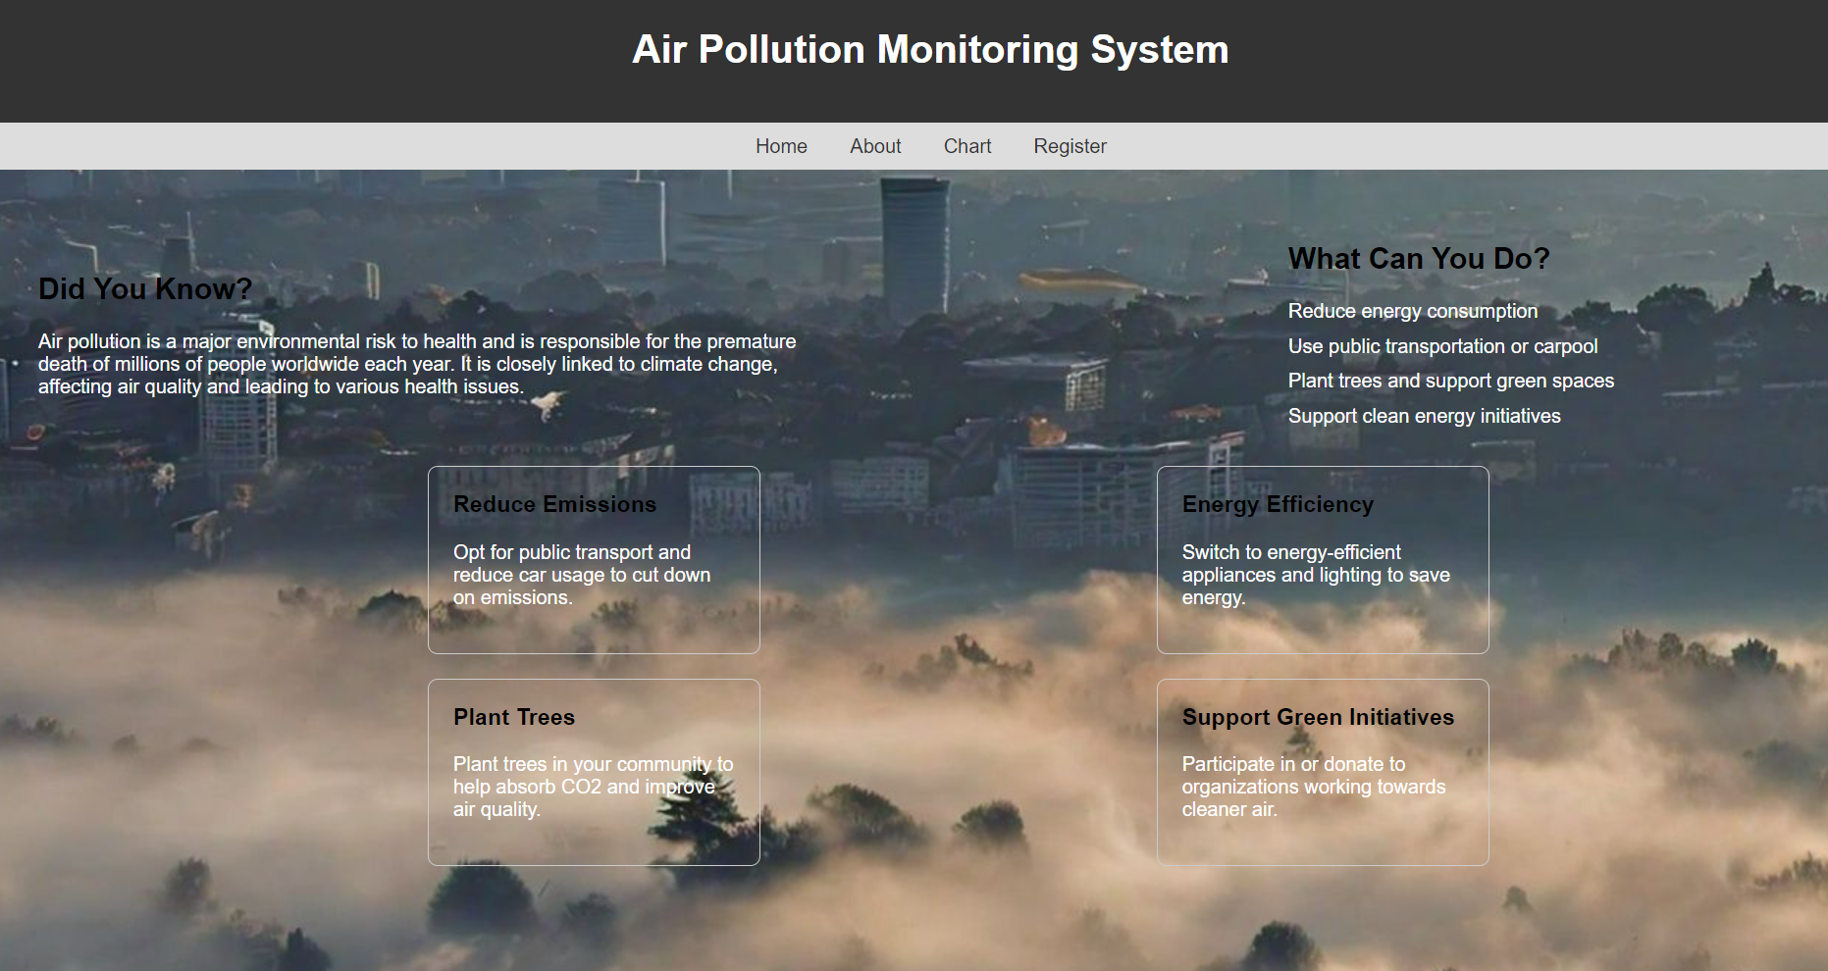
DISPLAY

Slide 13
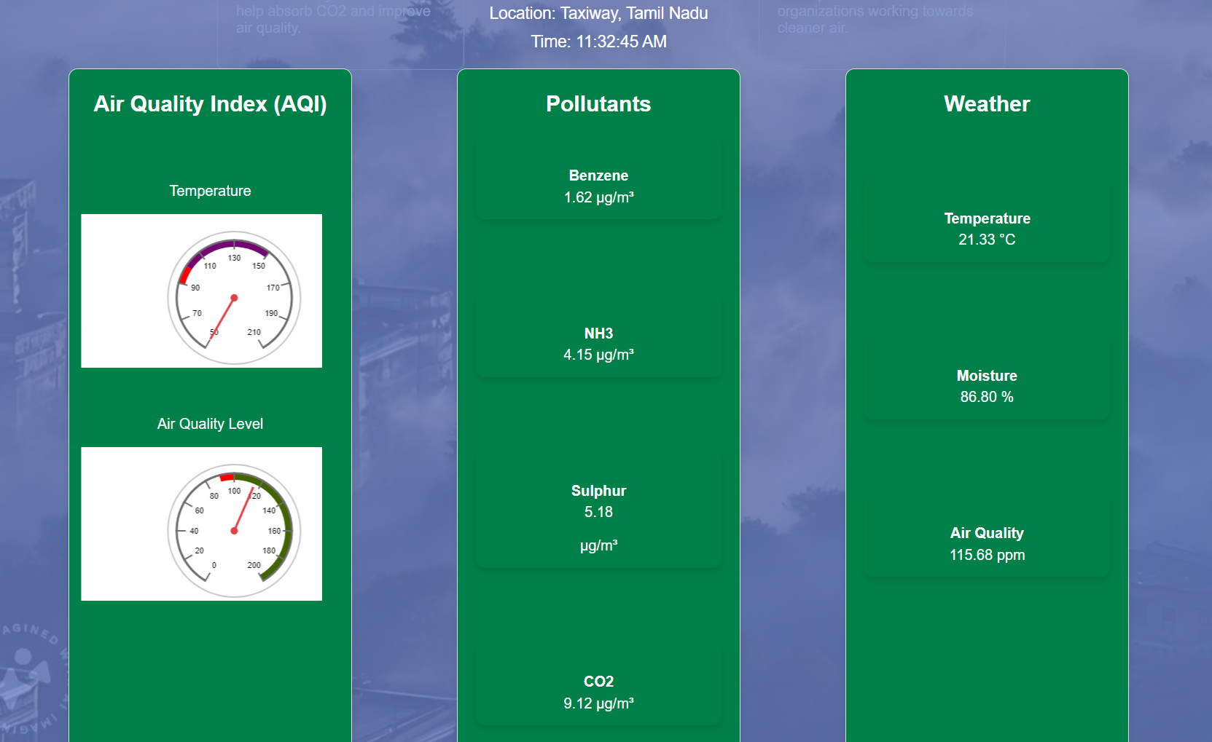
MONITORING AIR QUALITY INDEX:

Slide 14
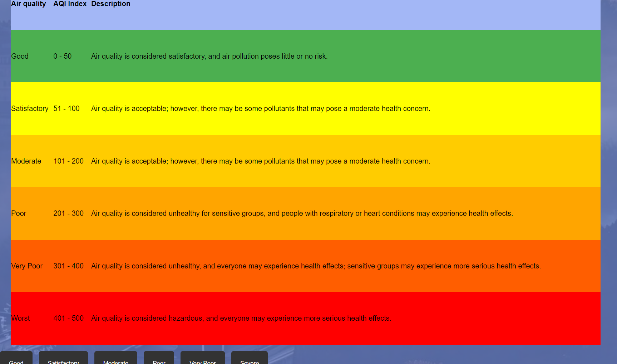
Description about the Air Quality
6/26/2024

Slide 15
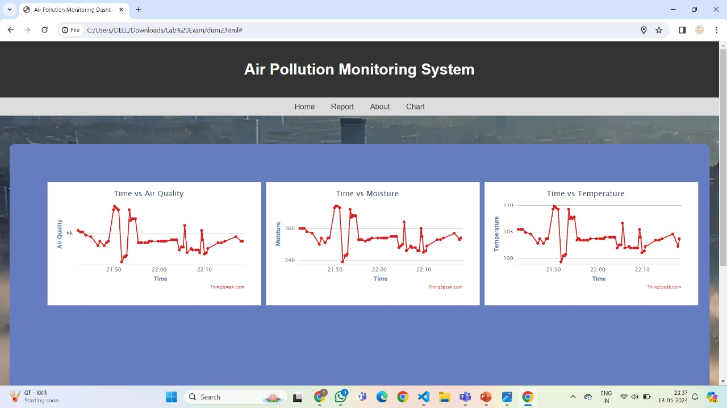

Slide 16
Future Scope
Mobile and Wearable Devices: Develop portable and wearable air quality monitoring devices that allow individuals to monitor their personal exposure to pollutants in real time, providing personalized health recommendations and alerts.
Health Impact Studies: Collaborate with healthcare providers and researchers to study the long-term health impacts of air pollution and assess the effectiveness of various pollution mitigation measures.
Expanded Sensor Networks: Deploy a denser network of sensors across urban and rural areas to provide more granular air quality data, enabling more precise local monitoring and analysis.

